Slide 1

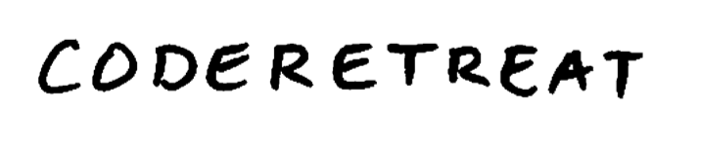

Slide 2
CodeRetreat
CodeRetreat
is a single day event
Where programmers of
all levels Gather together
to make space and
focus on practicing
their craft
Practice
Practice
Practice
Practice
Notes:
Making space is like setting up your own little world where you experiment without any interruptions.

Slide 3
Schedule
9:30 – 10:00 Introduction
10:00-11:00 Session 1
11:00-12:00 Session 2
Session
40 mins - Code
11:00-12:00 Lunch
10 mins - Retro
1:00 - 2:00 Session 3
10 mins - Break
2:00 - 3:00 Session 4
3:00 - 4:00 Session 5
4:00 - 4:30 Closing Circle

Slide 4
Practice vs. Performance

Slide 5
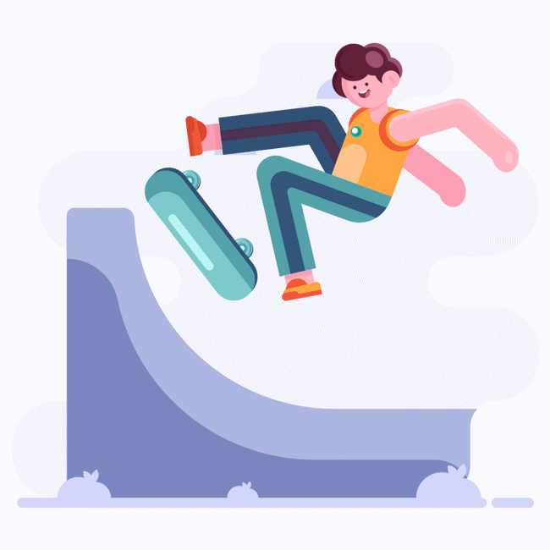
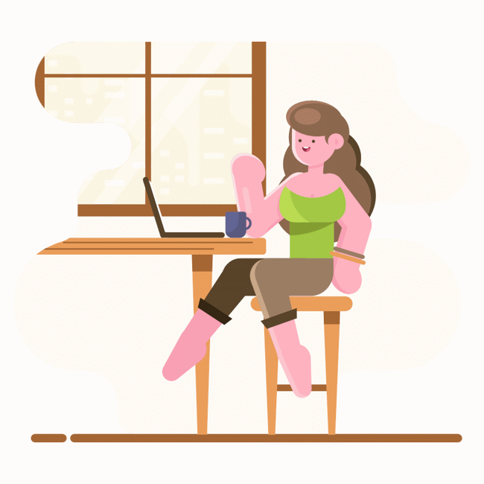

Benefits of Deliberate Practice
Have Fun
Improve your skills
Meet People

Slide 6
your Organizers are here to Help

Slide 7
What are the virtues of good code?

Slide 8
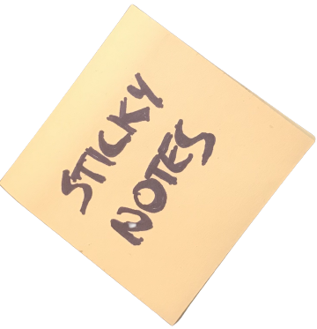
Sticky Notes
By Michael Sahota
Compiled by Llewellyn Falco

Slide 9
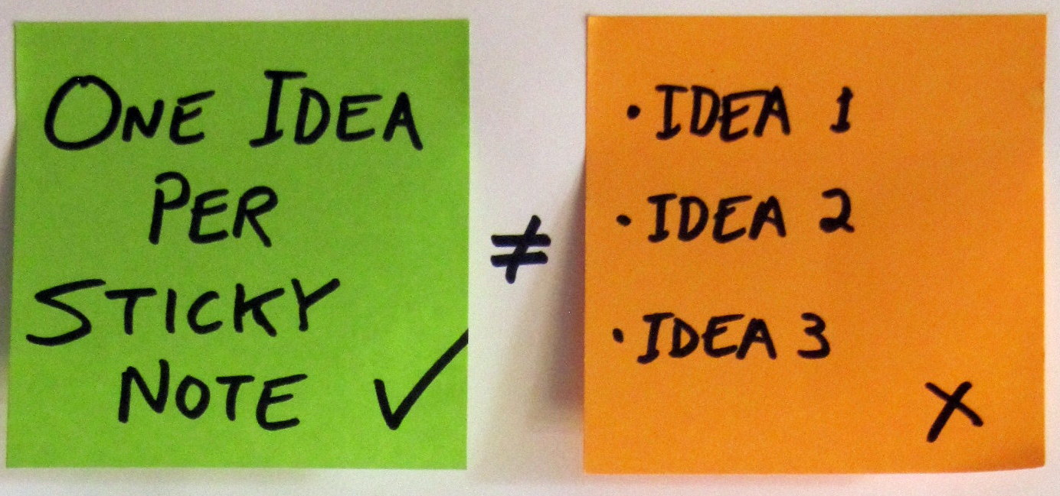

Slide 10
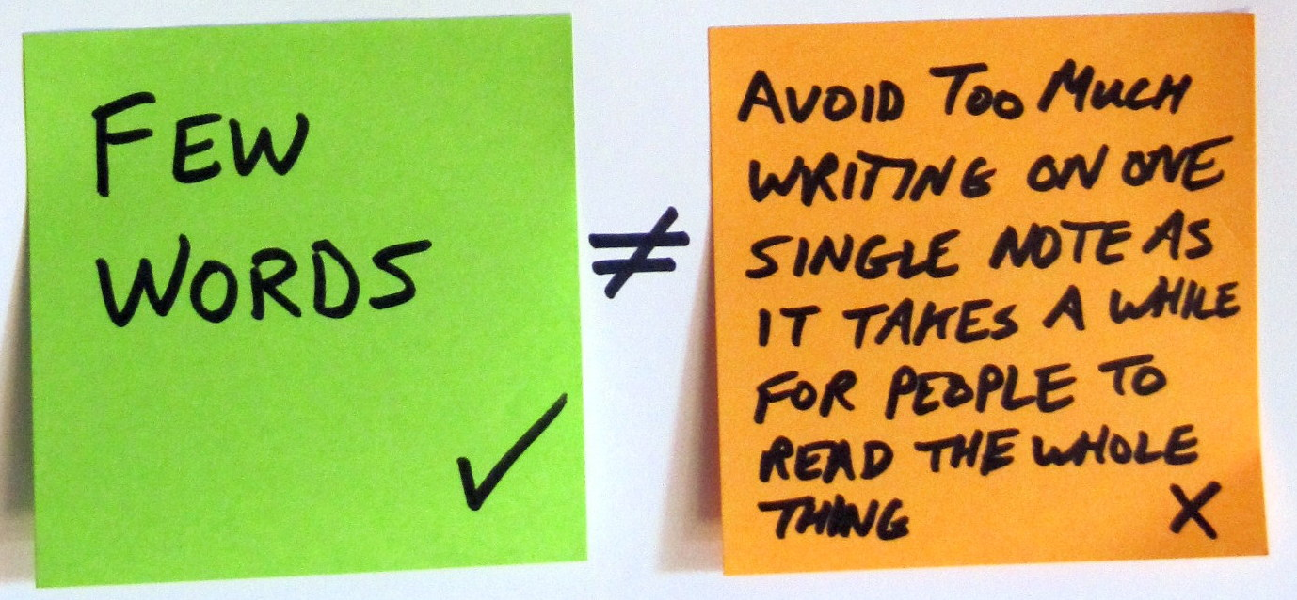

Slide 11
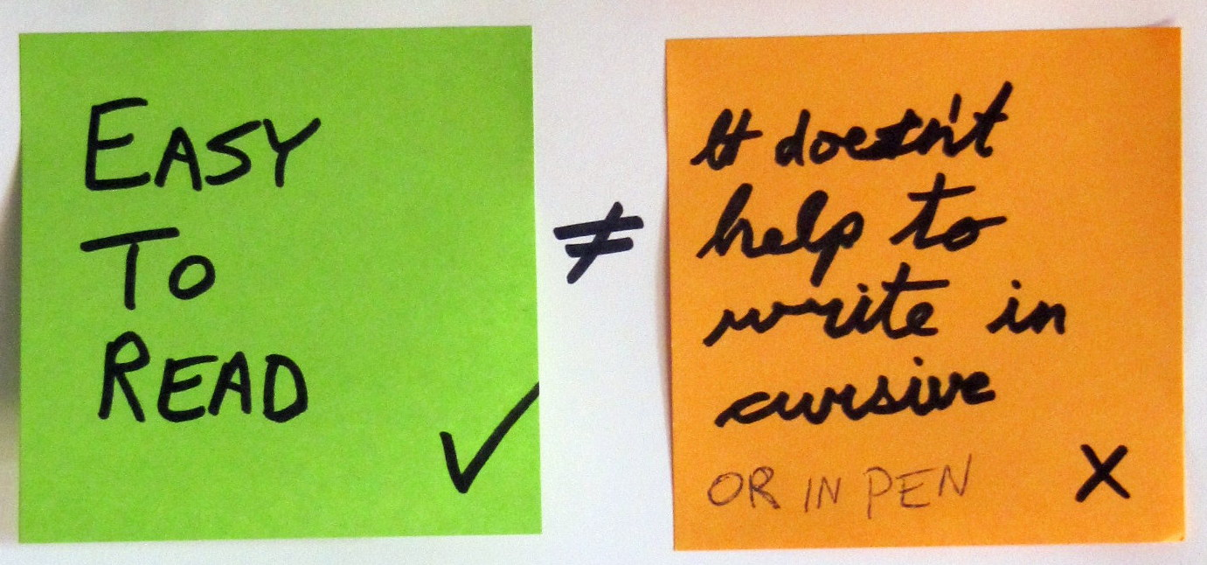

Slide 12
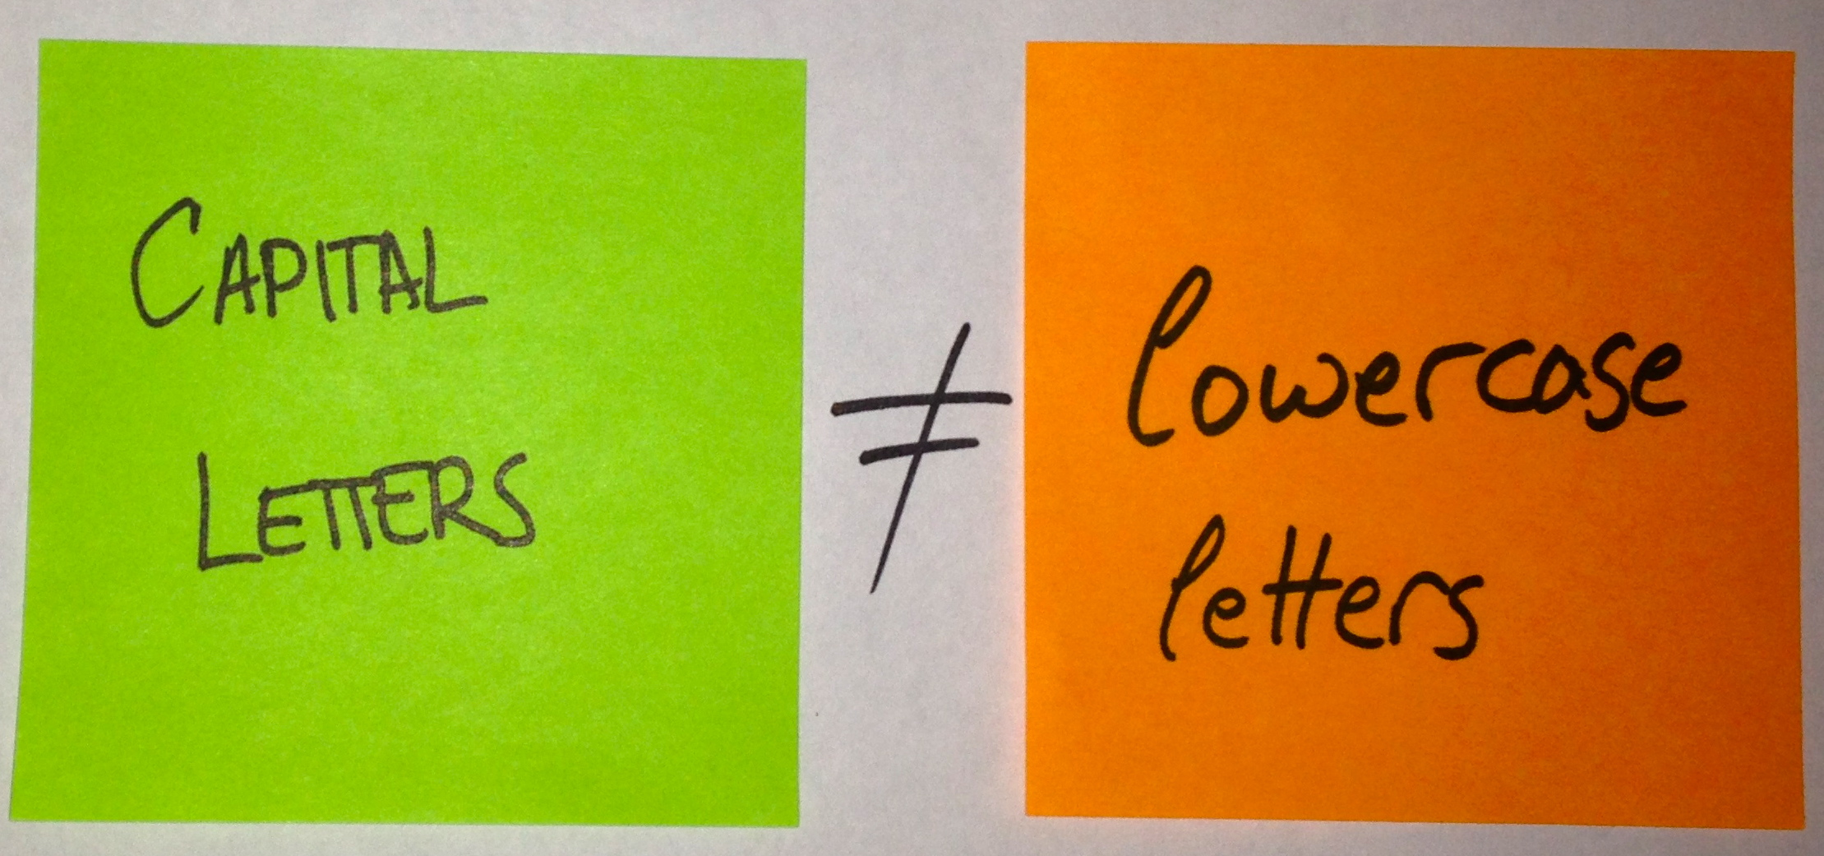

Slide 13
Notes:
Notice how easier the left side is to read and look at than the right side

Slide 14
Lazy person fact #6543671283
You were too lazy to read that number

Slide 15
What are the virtues of good code?

Slide 16
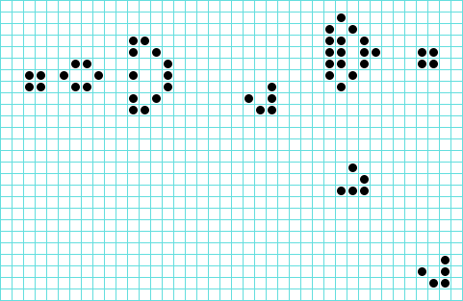
Conway’s Game of Life
Conway’s Game of Life is grounded in basic concepts,
yet exhibits complex emergent behavior…

Slide 17






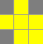






4 or more neighbors
1 neighbor or less
2-3 neighbors
3 neighbors
0
1
2
3
3
4
5
6
Middle square
dies
from Starvation
Middle square survives
from Subsistence
Middle square
is born
Middle square
dies
from Overpopulation
Game of Life
Rules

Slide 18

The value of constraints
The Value of
Constraints
focus

Slide 19
Test Driven Development
Refactoring
Elements of Simple Design
New Programming Languages
?
their craft
Pair Programming
Mob Programming
Emergent Design

Slide 20
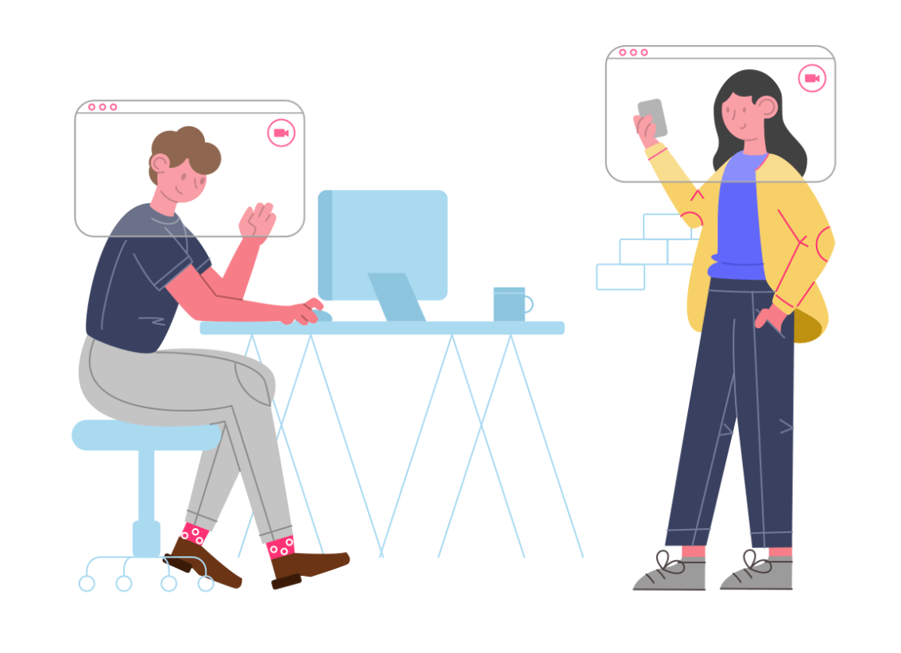
What you take away is your responsibility
Notes:
I want to share with you that what you take away from this event is your responsibility.
What we have done is created a space where it is easy to practise, it is safe to try new things and have them fail, where we respect that everyone has come here with a different background and level of experience.

Slide 21

Kindness
Consideration
and
Respect
Working Agreements
Make for better pairs & mobs

Slide 22
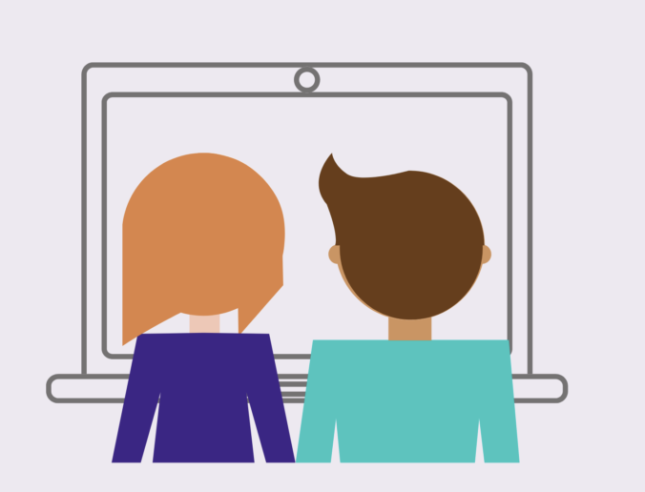
“For an idea to go from your head to the computer it must go through someone else’s hands”
1. Idea
2. speak
3. Type
Strong Style
Pair Programming

Slide 23
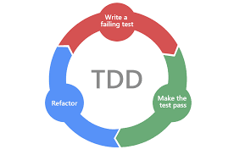
Test Driven Development
Write a
failing test
Make the
test pass
Refactor

Slide 24
How to get the most out of code retreat
COMFORT
ZONE
WHERE THE
MAGIC HAPPENS

Slide 25
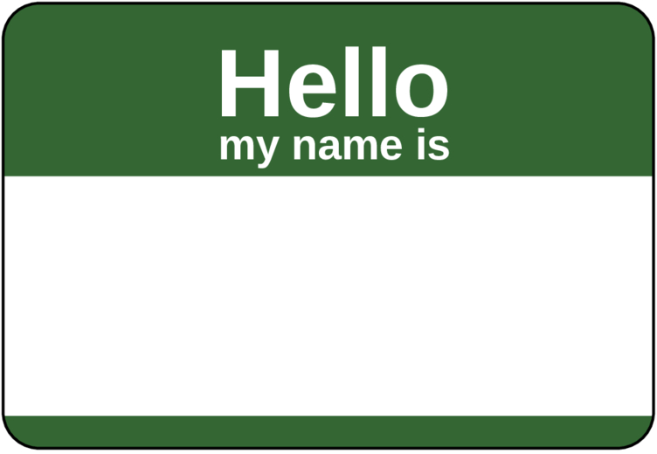
Name Tags
Llewellyn
have
want
java c# python c++
typescript mobbing
approvaltests
weird languages
rust prolog elm

Slide 26
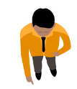






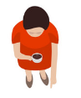


Speed Meet

Slide 27
Find your pair and let’s get Started…

